Slide 1
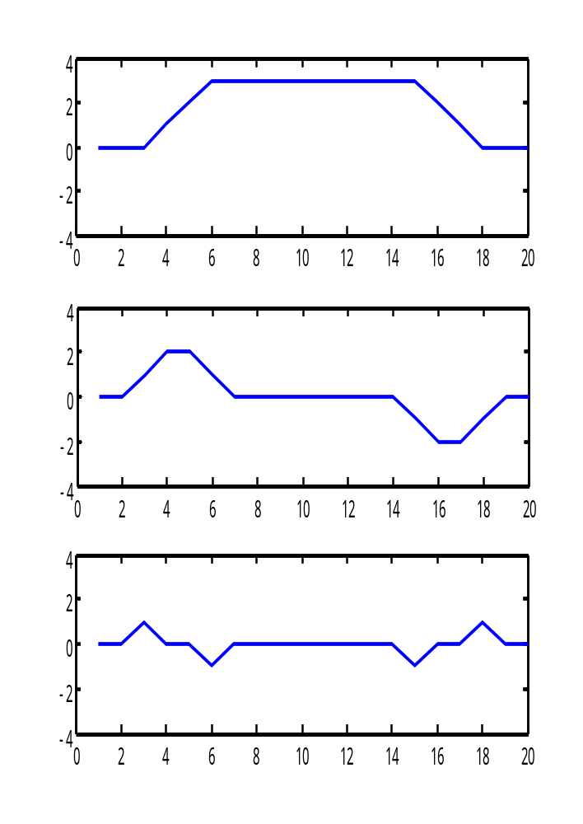
Yesterday’s review : About the meaning of Filter Mask
>> ftest=[ 0 0 0 1 2 3 3 3 3 3 3 3 3 3 3 2 1 0 0 0 ];
>> wD=[1 0 -1];
>> wS=[1 -2 1];
>> gtest1=conv_1d(ftest,wD)
>> gtest2=conv_1d(ftest,wS)
>> figure,
>> subplot(3,1,1), plot(ftest)
>> subplot(3,1,2), plot(gtest1)
>> subplot(3,1,3), plot(gtest2)
>>
First derivative filter mask
Second derivative mask

Slide 2
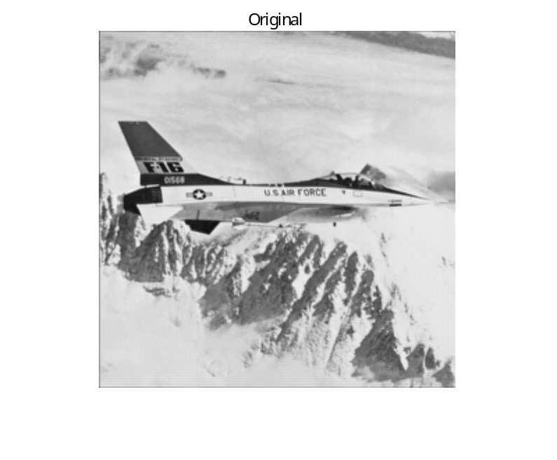
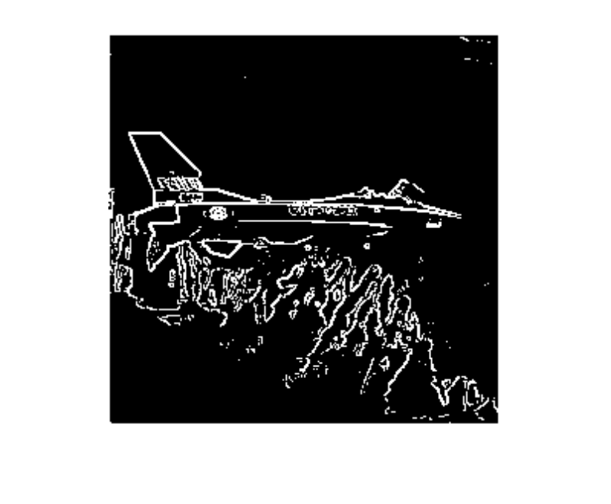
Yesterday’s review : edge detection
Threshold
function [ g ] = detect_edge( f, t )
wSv=[-1 -2 -1; 0 0 0; 1 2 1 ] ;
wSh=wSv‘ ;
gv = conv_2d(f, wSv) ;
gh = conv_2d(f, wSh) ;
abs_g = abs(gv) + abs(gh) ;
abs_g = mat2gray(abs_g) ;
g = abs_g > t ;
figure, imshow(g, [ ])
end
>> imread(airplane.bmp) ;
>> g_edge=detect_edge(f, 0.3) ;

Slide 3
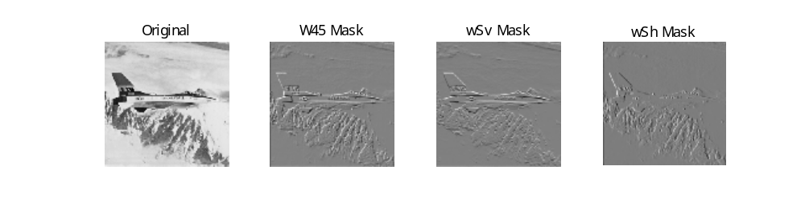
Yesterday’s review : edges at 45 degree
>> w45=[-2 -1 0; -1 0 1; 0 1 2]
w45 =
-2 -1 0
-1 0 1
0 1 2
>> gw45=conv_2d(f,w45);
>> figure, imshow(gw45,[ ]), title('W45 Mask')

